Slide 1
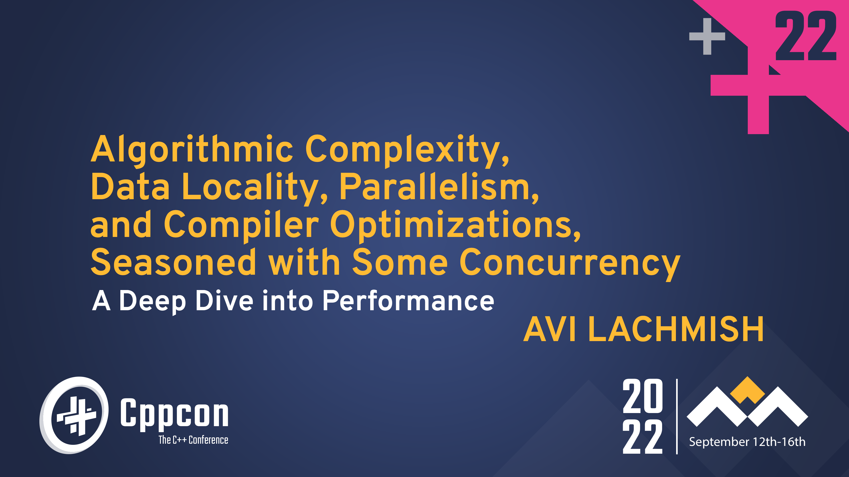

Slide 2

About Me
Head of development group with many years of experience
Extensive experience in C++ (98,03,11,14,17 and 20), part of the C++ Israel NB
Work for Incredibuild

Slide 3
Cache Friendly Software
HW and Software interact
HW cache will affect your performance
No matter what programming language
No matter what App you develop

Slide 4
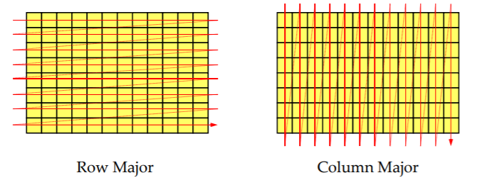
Cache Friendly Software
Traverse by columns vs Traverse by rows
Two ways to traverse a matrix both are doing the same amount of work and using the same amount of memory

Slide 5
Cache Friendly Software
Traverse by columns vs Traverse by rows
Demo
Why does traverse matter?

Slide 6
CPU Caches
Much less memory but faster:
Holds the content of recently access memory locations
Access latency is much shorter than for main memory
Three common types:
Data (D-cache, D$)
Instruction (I-cache, I$)
Translation lookaside buffer (TLB)

Slide 7
Cache Hierarchies
multi-level caches
E.g., Intel Core i7-10xx processor (on my machine):
32KB L1 I-cache, 32KB L1 D-cache per core
256KB L2 cache per core
Holds both instructions and data
8MB L3 cache
Holds both instructions and data
Demo on my machine

Slide 8
Cache Hierarchies
multi-level caches

Slide 9
CPU Cache Characteristics
Caches much faster than main memory
For Core i7-9xx:
L1 latency is 2 - 4 cycles (read vs. write)
L2 latency is ~10 cycles
L3 latency is ~40 cycles
Main memory latency is ~100 cycles
much slower than L1!
100% CPU utilization ⇒ >99% CPU idle time!

Slide 10
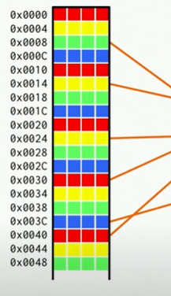
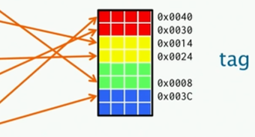
Cache model
K= 2 Way associative Cache
Cache Line
Cache size M =32
Line/Block size B = 4
Real Memory
Cache Size
W – bit address size
A cache line’s set determines k possible cache locations
 | tag | set | offset
bits | W-lg(M/K) | Lg(M/KB) | Lg(B)

Slide 11
Cache Lines
Caches consist of lines, each holding multiple adjacent words
On Core i7, cache lines hold 64 bytes.
64-byte lines common for Intel/AMD processors.
64 bytes = 16 32-bit values, 8 64-bit values, etc.
E.g., 16 32-bit array elements.
Main memory read/written in terms of cache lines
Read byte not in cache ⇒ read full cache line from main memory.
Write byte ⇒ write full cache line to main memory (eventually).

Slide 12
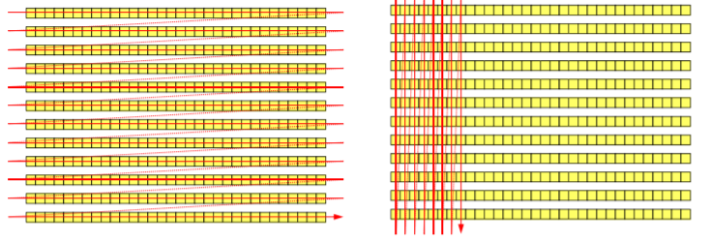
Cache Line
Explains why row-major matrix traversal better than column-major

Slide 13
Cache Line Prefetching
Hardware speculatively prefetches cache lines:
Forward traversal through cache line n ⇒ prefetch line n+1
Reverse traversal through cache line n ⇒ prefetch line n-1

Slide 14
Implications
Locality counts:
Reads/writes at address A ⇒ contents near A already cached.
E.g., on the same cache line.
E.g., on nearby cache line that was prefetched.
Predictable access patterns count.
“Predictable” ≅ forward or backwards traversals.
Linear array traversals very cache-friendly.
Excellent locality, predictable traversal pattern.
Linear array search can beat log2 n searches of heap-based BSTs.
log2 n binary search of sorted array can beat O(1) searches of heap-based hash tables.
Big-Oh wins for large n, but cache friendly software takes early lead.

Slide 15
Taxonomy of cache miss
Cold Miss
The first time a cache block is accessed
Capacity Miss
The accessed memory was recently evicted due to cache being full and the eviction would have occurred even if the cache was fully associative
Conflict Miss
Too many cache lines in the same set in the cache. The cache line would not have been evicted with a fully associative cache
Sharing Miss
Other processors are accessing the same data on the cache line
True Sharing Miss: 2 processors are accessing the same data on the cache line
False Sharing Miss: 2 processors are accessing different data on the cache line

Slide 16
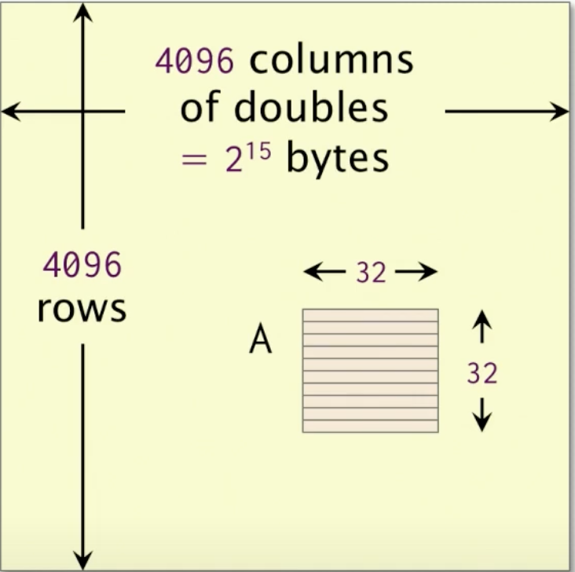
Conflict Miss - example
$ conflicts can be problematic for $ with limited associativity
Assume
Word width w = 64
L1 Cache size M = 32K
Line (Block) size B = 64 Bytes
K=8-way associativity
tag | set | offset
W – lg(M/K) | Lg(M/KB) | Lg(B)

Slide 17
Conflict Miss - example
$ conflicts can be problematic for $ with limited associativity
Assume
Word width w = 64
L1 Cache size M = 32K
Line (Block) size B = 64 Bytes
K=8-way associativity
tag | set | offset
W – lg(M/K) | Lg(M/KB) | Lg(B)
 |  | 6

Slide 18
Conflict Miss - example
$ conflicts can be problematic for $ with limited associativity
Assume
Word width w = 64
L1 Cache size M = 32K
Line (Block) size B = 64 Bytes
K=8-way associativity
tag | set | offset
W – lg(M/K) | Lg(M/KB) | Lg(B)
 | 6 | 6

Slide 19
Conflict Miss - example
$ conflicts can be problematic for $ with limited associativity
Assume
Word width w = 64
L1 Cache size M = 32K
Line (Block) size B = 64 Bytes
K=8-way associativity
tag | set | offset
W – lg(M/K) | Lg(M/KB) | Lg(B)
52 | 6 | 6

Slide 20
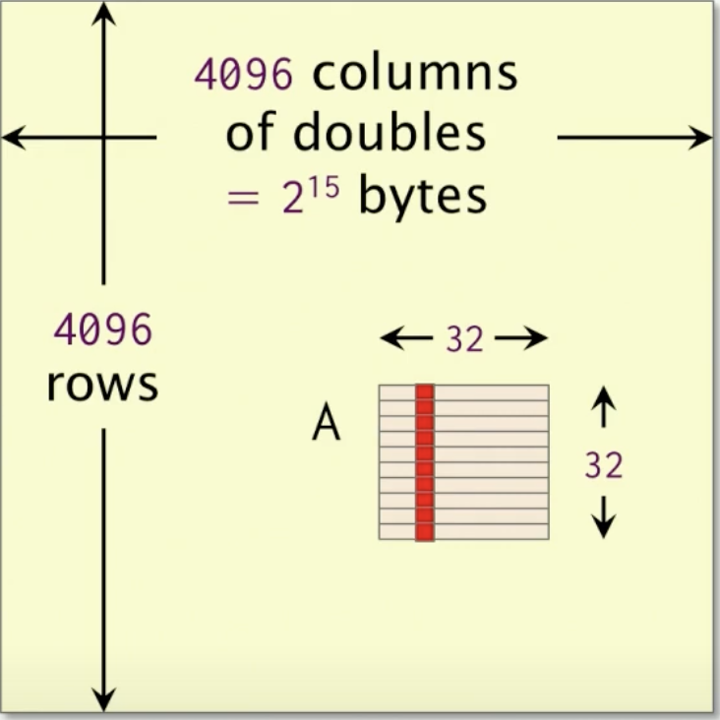
Conflict Miss - example
$ conflicts can be problematic for $ with limited associativity
Assume
Word width w = 64
L1 Cache size M = 32K
Line (Block) size B = 64 Bytes
K=8-way associativity
tag | set | offset
W – lg(M/K) | Lg(M/KB) | Lg(B)
52 | 6 | 6
Analysis
Look at the column of a sub-metrix A
The address of the elements are x, x+2^15, x+2*2^15, …, x+31*2^15

Slide 21
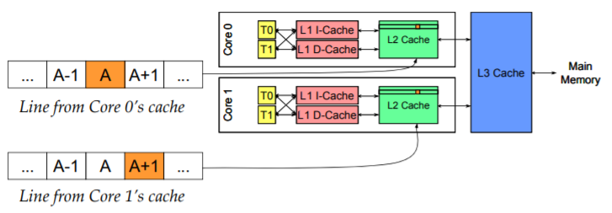
False Sharing
Demo
Suppose Core 0 accesses A and Core 1 accesses A+1.
Independent pieces of memory; concurrent access is safe.
But A and A+1 probably map to the same cache line.
If so, Core 0’s writes to A invalidates A+1’s cache line in Core 1.
And vice versa.
This is false sharing

Slide 22
Prefetcher
Stride Matrix
Summing an Array containing 100M integers
Prefetcher works with sequential and stride memory access
Prefetcher is powerless with random memory access
Why is it a diff in the stride case
 | Sequential i = 0,1,2,3 … | Stride i = 0,16,32… | Random i = random
Runtime | 180ms | 740ms | 6600ms

Slide 23
Prefetcher
Stride Matrix
To utilize the cache
Arrange the data so members that are access together are close in memory
Try to use all the data in the cache line
 | Sequential i = 1,2,3 … | Stride i = 0,2,4… | Stride i = 0,16,32…
Runtime | 180ms | 210ms | 740ms
Percentage of data actual read from the cache line | 100% | 50% | 6%

Slide 24
Avoid pointers in types
struct Shape { … };
struct Circle final : Shape { … };
struct Square final : Shape { … };
struct Button {
std::string label;
std::unique_ptr shape;
};

Slide 25
Avoid pointers in types
struct Shape { … };
struct Circle final : Shape { … };
struct Square final : Shape { … };
struct Button {
std::string label;
std::unique_ptr shape;
};
struct Shape { … };
struct Circle final : Shape { … };
struct Square final : Shape { … };
struct Button {
std::string label;
std::variant<Circle, Square > shape;
};

Slide 26
Do not load to cache what you are not going to use
struct MyData {
int id;
Data lots_of_data;
};
std::find_if(data.begin(), data.end(), [&](const MyData& d) {
return d.id == id; });
Tip: Consider replacing big objects with pointers to heap-allocated big objects
0-int | lots_of_data | 1-int | lots_of_data | 2-int | lots_of_data

Slide 27
Cache friendly Containers
Main cache is slow
Cache prefetcher works best for predictable linear memory access
Best Practice
Use containers that have contiguous memory, no pointer chasing
We should usually choose std::vector (on c++23 flat_set and flat_map)

Slide 28
Code is memory too
Code is also cached
Same caching behavior as data!
Rearrange branches (put cold away from hot)
Avoid function pointer/virtual
likely/unlikely attributes (C++20)

Slide 29
Summary
Small is fast - better fits the cache
Locality Counts
Temporal locality
Spatial locality
Predicted access patterns count
Avoid loading to cache what you are not going to use
Prevent eviction of data intended for reuse

Slide 30
Object Oriented Design
Structure the program based on “real-world” entities
struct Shape {
Shape(const Shape&) = delete;
Shape& operator=(const Shape&) = delete;
virtual ~Shape() = 0;
virtual void draw(Window& window) const = 0;
virtual float area() const = 0;
private:
Color m_color;
bool m_is_visible;
};

Slide 31
Object Oriented Design
struct Circle final : Shape {
void draw(Window& window) const override {
if (is_visible()) {
…
} }
float area() const override { … }
private:
Point m_center;
float m_radius;
};

Slide 32
Object Oriented Design
struct Square final : Shapes {
void draw(Window& window) const {
if (is_visible()) {
…
}
}
float area() const override { … }
private:
Point m_top_left;
float m_size;
};

Slide 33
Object Oriented Design
std::vector<std::unique_ptr> shapes = …;
for (auto& ptr : shapes)
ptr->draw(window);
float total_area = 0;
for (auto& ptr : shapes)
total_area += ptr->area();

Slide 34
Object Oriented Design
Cache Unfriendly
Cache-unfriendly indirection due to std::unique_ptr
Wasted cache line space
Function pointers in hot loop
Invisible entities are processed as well

Slide 35
Data Oriented Design
Structure the program by following the flow of data
What are we trying to do?
Draw Shapes
Calculate Area of Shapes
What do we need for that?
Drawing: color and geometry information
Area: geometry information

Slide 36
Data Oriented Design
struct CircleGeometry {
Point center;
float radius;
};
struct SquareGeometry {
Point top_left;
float size;
};
struct ShapesGeometry {
std::vector circles;
std::vector squares;
};

Slide 37
Data Oriented Design
float total_area(const ShapesGeometry& geometry) {
float result = 0;
for (auto& circ : geometry.circles)
…
for (auto& square : geometry.squares)
…
return result;
}

Slide 38
Data Oriented Design
struct ShapeID {
ShapeKind kind;
std::size_t index;
};
struct ShapesRender {
std::vector<std::pair> visible;
};

Slide 39
Data Oriented Design
void draw(Window& window, const ShapesRender& render, const ShapesGeometry& geometry) {
for (auto [id, color] : render.visible)
if (id.kind == ShapeKind::circle)
draw_circle(window, geometry.circles[id.index], color);
else if (id.kind == ShapeKind::square)
draw_square(window, geometry.square[id.index], color);
}

Slide 40
Data Oriented Design
Tips
Group data based on how it is actually going to be used
Implement the common task, not the special case
Eliminate booleans and object states by making them implicit

Slide 41
Data Oriented Design
One step further:
struct ShapesRender
{
std::vector<ShapeKind> kind;
std::vector<std::size_t> index;
std::vector<Color> color;
};

Slide 42
Data Oriented Design
Classical OOP: Arrays of Structs (AoS)
CPU friendly: Struct of Arrays (SoA)
Pros
SoA is cache friendly
Cons
SoA is more inconvenient!

Slide 43
Guidance
For Data
Avoid using pointers in types
Use as much of the cache line as possible (DOD vs OOD)
Make data access predictable
Watch out for false sharing in MT systems
Cache-oblivious algorithm

Slide 44
Guidance
For Code
Fit working set in cache
Avoid iteration over heterogeneous sequences with virtual calls
E.g., sort sequences by type DOD
Make “fast paths” branch-free sequences
Use up-front conditionals to screen out “slow” cases
Inline cautiously:
The good:
Reduces branching
Facilitates code-reducing optimizations
The bad:
Code duplication reduces effective cache size
Take advantage of PGO (Profile Guided Optimization) and WPO (Whole program optimization)
Notes:
PGO – Profile Guided Optimization
WPO - Whole program optimization

Slide 45
Conclusion
most importantly
Use benchmarks and profiling tools!
Measure Measure and Measure

Slide 46
Questions?

